Slide 1
Cloud Computing 1100101 (101)

Slide 2
Cloud Computing – Outline
Definition of Cloud Computing
Early days of “Cloud” Computing – 1960s – 1970s
Developments that made the idea of Cloud Computing possible
Explanation and Benefits of Cloud Computing
Types of Cloud Computing
Cloud Computing Services
Future of Cloud Computing

Slide 3
Cloud Computing - Definition
Cloud computing is a computing style in which scalable and flexible IT functionalities are delivered as a service to external customers using Internet technologies
Cloud computing is network-based computing in which large groups of remote servers are networked to allow the centralized data storage, and online access to computer services or resources

Slide 4
Cloud Computing - Origins
1960s and 1970s
  Mainframe Time-Sharing Systems
    time-sharing is the sharing of a computing resource among many users by means of multiprogramming and multi-tasking
    Computer terminals (“static terminals”) linked to a large mainframe computer
    These systems were used at Universities to give faculty and students access to a central computer.
      Ex. Berkeley Timesharing System and the Dartmouth Time Sharing System

Slide 5
Cloud Computing – Origins (cont)
Service Bureaus
  Companies started providing time sharing services for their mainframe computers
    Ex. Tymshare and The Service Bureau Corporation (subsidiary of IBM)
    Service bureau entities would rent the time on their machines by the hour to other companies
    These service bureaus were used by companies to run payroll and other tasks

Slide 6
Cloud Computing – Developments
Developments that made what would become the idea of Cloud Computing possible
  High capacity fiber optic networks
    In the 1990s telecommunications companies started to invest in high capacity fiber optic networks which increase the network capacity making it possible to exchange information over a shared network
Virtualization
  Virtualization software separates a physical computing device into one or more “virtual” devices
  Each “virtual” device can be used to perform computing tasks
  This provides better allocation of computing resources

Slide 7
Cloud Computing - Explanation
  In the simplest terms, cloud computing means storing and accessing data and programs over the Internet instead of your computer's hard drive.
  Cloud computing is not:
    When you store data on--or run programs from the hard drive, that's called local storage and computing.
    Storing data on a home or office network does not count as utilizing the cloud
  Cloud computing relies on sharing of resources to achieve coherence and economies of scale.
  Cloud computing allows companies to avoid upfront infrastructure costs, and focus on projects that differentiate their businesses instead of on infrastructure.
Notes:
The cloud is just a metaphor for the Internet. It goes back to the days of flowcharts and presentations that would represent the gigantic server-farm infrastructure of the Internet as nothing but a puffy, white cumulonimbus cloud, accepting connections and doling out information as it floats.

Slide 8
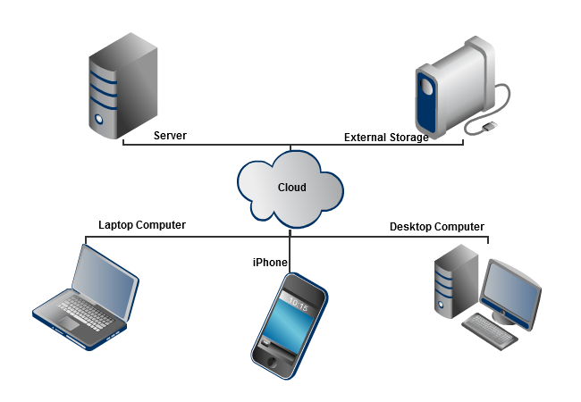
Cloud Computing - Diagram

Slide 9
Cloud Computing – Benefits
Reliability
  Websites are hosted on virtual partitions from more than one physical server so that if one server goes down it has no impact to the website
Physical Security
  Servers are housed in data centers which provide greater security than on-site hosting
Scalability and Flexibility
  Resource are available in real time on demand and not limited to the physical constraints/capacity of one server
Utility Style Costing
  the client only pays for what they actually use
Responsive Load Balancing
  Spreads workloads across resources the maximize throughput

Slide 10
Cloud Computing – Types of Clouds
Types of Clouds
  Public Cloud
  Private Cloud
  Hybrid Cloud

Slide 11
Cloud Computing – Public Cloud
Public Cloud
  Services are provided in a virtualized environment, constructed using pooled shared physical resources, and accessible over a public network such as the internet.
  A service provider makes resources, such as applications and storage, available to the general public over the Internet.
    Amazon Web Services (S3)
Notes:
To some extent they can be defined in contrast to private clouds which ring-fence the pool of underlying computing resources, creating a distinct cloud platform to which only a single organisation has access. Public clouds, however, provide services to multiple clients using the same shared infrastructure.

Slide 12
Cloud Computing – Private Cloud
Private Cloud
  A model of cloud computing that involves a distinct and secure cloud based environment in which only the specified client can operate
  Private clouds will provide computing power as a service within a virtualized environment using an underlying pool of physical computing resource
  The cloud is only accessible by a single organization providing that organization with greater control and privacy
  Private clouds are similar to traditional local access networks (LANs) but with the added ability of virtualization
  Amazon Virtual Private Cloud (Amazon VPC)

Slide 13
Cloud Computing – Private Cloud (cont)
Amazon VPC
  Lets you provision a logically isolated section of the Amazon Web Services (AWS) Cloud where you can launch AWS resources in a virtual network that you define.
  Complete control over your virtual networking environment, including selection of your own IP address range, creation of subnets, and configuration of route tables and network gateways.
  Can create a Hardware Virtual Private Network (VPN) connection between your corporate datacenter and your VPC and leverage the AWS cloud as an extension of your corporate datacenter.

Slide 14
Cloud Computing – Hybrid Cloud
Hybrid Cloud
  An integrated cloud service utilizing both private and public clouds to perform distinct functions within the same organization
  Public Cloud solutions are generally more cost efficient than Private Clouds
  Example:
    An organization may store sensitive client data in house on a private cloud application
    Interconnect that application to a business intelligence application provided on a public cloud as a software service.

Slide 15
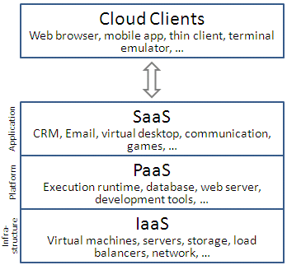
Cloud Computing - Services
Services
  Software as a Service (SaaS)
  Platform as a Service (PaaS)
  Infrastructure as a Service (IaaS)

Slide 16
Cloud Computing - SaaS
SaaS
  Users are provided access to application software and databases
  SaaS is typically accessed by users using a thin client via a web browser.
  Cloud providers manage the infrastructure and platforms that run the applications
  SaaS is sometimes referred to as "on-demand software" and is usually priced on a pay-per-use basis
  Example: Sell on Amazon (Marketplace)
Notes:
Thin clients have their roots in multi-user systems, traditionally mainframes accessed by some sort of terminal computer
In the SaaS model, cloud providers install and operate application software in the cloud and cloud users access the software from cloud clients.
Cloud users do not manage the cloud infrastructure and platform where the application runs.
This eliminates the need to install and run the application on the cloud user's own computers, which simplifies maintenance and support.
Cloud applications are different from other applications in their scalability—which can be achieved by cloning tasks onto multiple virtual machines at run-time to meet changing work demand.^{[54]} Load balancers distribute the work over the set of virtual machines.
This process is transparent to the cloud user, who sees only a single access point. To accommodate a large number of cloud users, cloud applications can be multitenant, that is, any machine serves more than one cloud user organization.

Slide 17
Cloud Computing – SaaS (cont)
SaaS – Sell on Amazon (Marketplace)
  Seller Central is a Web interface used to manage all aspects of selling on Amazon.com.
  A Seller can add product information, make inventory updates, manage orders, and manage payments through a suite of tools.
  Fees are paid when a sellers product is purchased by a customer
Notes:
Example: TurboTax

Slide 18
Cloud Computing - PaaS
PaaS
  Delivers cloud-based application development tools in addition to services for testing, deploying, collaborating, hosting, and maintaining applications.
  PaaS offerings facilitate the deployment of applications or services without the cost and complexity of buying and managing the underlying hardware and software and provisioning hosting capabilities
  Example, AWS Elastic Beanstalk
Notes:
Features in PaaS offering:
Operating system
Server-side scripting environment
Database management system
Server Software
Support
Storage
Network access
Tools for design and development
Hosting
Software developers, web developers and businesses can benefit from PaaS. Whether building an application which they are planning to offer over the internet or software to be sold out of the box, software developers may take advantage of a PaaS solution. For example, web developers can use individual PaaS environments at every stage of the process to develop, test and ultimately host their websites. However, businesses that are developing their own internal software can also utilise Platform as a Service, particularly to create distinct ring-fenced development and testing environments.

Slide 19
Cloud Computing – PaaS (cont)
PaaS – Elastic Beanstalk
  Developers simply upload their application, and Elastic Beanstalk automatically handles the deployment details of capacity provisioning, load balancing, auto-scaling, and application health monitoring.
  Automates the details of capacity provisioning, load balancing, auto scaling, and application deployment – creating an environment that runs a version of your application
  Elastic Beanstalk lets you retain full control over the AWS resources powering your application. If you decide you want to take over some (or all) of the elements of your infrastructure, you can do so seamlessly by using Elastic Beanstalk's management capabilities.
Notes:
Elastic Beanstalk is the fastest and simplest way to deploy your application on AWS. You simply use the AWS Management Console, a Git repository, or an integrated development environment (IDE) such as Eclipse or Visual Studio to upload your application, and Elastic Beanstalk automatically handles the deployment details of capacity provisioning, load balancing, auto-scaling, and application health monitoring. Within minutes, your application will be ready to use without any infrastructure or resource configuration work on your part.
Elastic Beanstalk automatically scales your application up and down based on your applications specific need using easily adjustable Auto Scaling settings. For example, you can use CPU utilization metrics to trigger Auto Scaling actions. With Elastic Beanstalk, your application can handle peaks in workload or traffic while minimizing your costs.
Elastic Beanstalk provisions and operates the infrastructure and manages the application stack for you, so you don't have to spend the time or develop the expertise. Instead, you can focus on writing code rather than spending time managing and configuring servers, databases, load balancers, firewalls, and networks.

Slide 20
Cloud Computing - IaaS
IaaS
  These are solutions that provide users with physical or virtual resources that satisfy the requirements of the user applications in terms of CPU, memory, operating system and storage.
  The end user has full controls over the virtualized computer instance, and can customize the instance accordingly.
  Unlike purchasing the physical servers, IaaS is usually charged on a utility basis depending on the consumption of the resources.
  Example, AWS EC2
Notes:
In the most basic cloud-service model & according to the IETF (Internet Engineering Task Force), providers of IaaS offer computers – physical or (more often) virtual machines – and other resources. (A hypervisor, such as Xen, Oracle VirtualBox, KVM, VMware ESX/ESXi, or Hyper-V runs the virtual machines as guests.
Pools of hypervisors within the cloud operational support-system can support large numbers of virtual machines and the ability to scale services up and down according to customers' varying requirements.) IaaS clouds often offer additional resources such as a virtual-machine disk image library, raw block storage, and file or object storage, firewalls, load balancers, IP addresses, virtual local area networks (VLANs), and software bundles.^{[49]} IaaS-cloud providers supply these resources on-demand from their large pools installed in data centers.
For wide-area connectivity, customers can use either the Internet or carrier clouds (dedicated virtual private networks).
To deploy their applications, cloud users install operating-system images and their application software on the cloud infrastructure. In this model, the cloud user patches and maintains the operating systems and the application software.
Cloud providers typically bill IaaS services on a utility computing basis: cost reflects the amount of resources allocated and consumed.
EXAMPLES:
Enterprise infrastructure; by internal business networks, such as private clouds and virtual local area networks, which utilise pooled server and networking resources and in which a business can store their data and run the applications they need to operate day-to-day. Expanding businesses can scale their infrastructure in accordance with their growth whilst private clouds (accessible only by the business itself) can protect the storage and transfer of the sensitive data that some businesses are required to handle.
Cloud hosting; the hosting of websites on virtual servers which are founded upon pooled resources from underlying physical servers. A website hosted in the cloud, for example, can benefit from the redundancy provided by a vast network of physical servers and on demand scalability to deal with unexpected demands placed on the website.
Virtual Data Centers (VDC); a virtualised network of interconnected virtual servers which can be used to offer enhanced cloud hosting capabilities, enterprise IT infrastructure or to integrate all of these operations within either a private or public cloud implementation.

Slide 21
Cloud Computing – IaaS (cont)
IaaS – EC2
  EC2 allows users to rent virtual computers on which to run their own computer applications
  EC2 allows scalable deployment of applications by providing a Web service through which a user can boot an Amazon Machine Image to create a virtual machine (“instance”)
Notes:
An Amazon Machine Image (AMI) is a special type of virtual appliance that is used to instantiate (create) a virtual machine within the Amazon Elastic Compute Cloud ("EC2"). It serves as the basic unit of deployment for services delivered using EC2
In computing, a virtual machine (VM) is an emulation of a particular computer system.

Slide 22
Cloud Computing – Future Predictions
It’s estimated by 2016 over 25% of all applications will be on the cloud
50% of enterprises will have hybrid clouds by 2017
67% of CIOs are actively looking into how could technologies can better serve and collaborate with customers

